Slide 1
Numerical Analysis (2/7) Interpolation - approximation
University of Luxembourg - 2024
Master in Mathematics
Hadrien Beriot
Restricted

Slide 2
Outline
1. Interpolation overview
2. Polynomial interpolation
3. Approximation – data fitting

Slide 3

1. Interpolation overview

Slide 4
Discrete Data
t | 1.0 | 2.0 | 3.0 | 4.0 | 5.0 | 6.0
y | 1.9 | 2.7 | 4.8 | 5.3 | 7.1 | 2.4
There are many diﬀerent things we might want to do with such data…
Plot data on a graph and draw a curve through the data points
Infer data values between the points or predict values beyond the available data
Determine important parameters (e.g. birth/death rates) if the data represents a physical phenomenon
Approximate the derivative or integral, or quickly evaluate the function, if the data represents an underlying function
…
Objective: represent discrete data in terms of relatively simple functions for easy manipulation
Notes:
Steps 2 and 3—designing, analyzing, implementing, and
using numerical algorithms and software—are the main subject matter of scientiﬁc
computing, and of this course

Slide 5
The Importance of Interpolation
Traditionally, interpolation was used to compute approximate values of mathematical functions between tabulated values
Advent of computers/calculators has reduced this application, but interpolation remains a cornerstone of numerical analysis
But interpolation is more than just a data manipulation technique
Discrete → Continuous:
representing discrete data as a function (vs. a table) is key to bridging finite- and infinite-dimensional problems

Slide 6
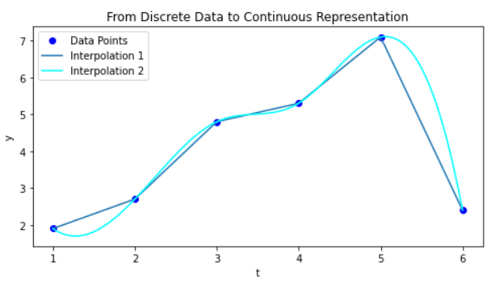
The Importance of Interpolation
t | 1.0 | 2.0 | 3.0 | 4.0 | 5.0 | 6.0
y | 1.9 | 2.7 | 4.8 | 5.3 | 7.1 | 2.4
Discrete
interpolation
Continuous
Notes:
What can you say about what you see?
Not unique
One has continuous derivatives, other one does not

Slide 7
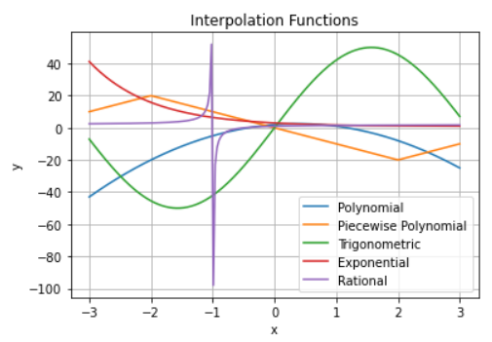
Type of functions used in interpolation
Exercise:
Can you recognize some of the function types used here?

Slide 8
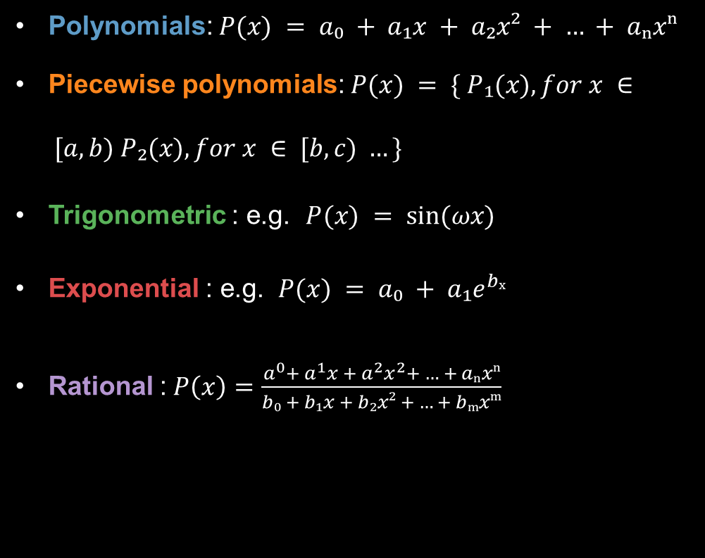
Type of functions used in interpolation
Polynomials: $P(x) = a₀ + a₁x + a₂x² + … + aₙxⁿ$
Piecewise polynomials: $P(x) = \{ P₁(x), for x ∈ [a, b) P₂(x), for x ∈ [b, c) …\}$
Trigonometric : e.g. $P(x) = sin⁡(ωx)$
Exponential : e.g. $P(x) = a₀ + a₁e^{bₓ}$
Rational : $P\left(x\right)=\frac{a^{0}+ a^{1}x + a^{2}x^{2}+ … + aₙxⁿ}{b₀ + b₁x + b₂x² + … + bₘxᵐ}$

Slide 9
2. Polynomial Interpolation

Slide 10
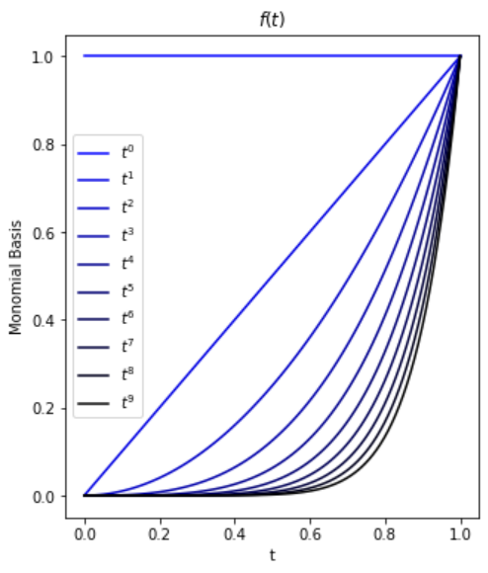
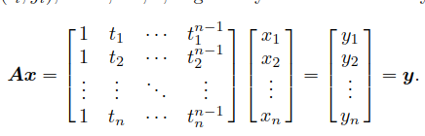

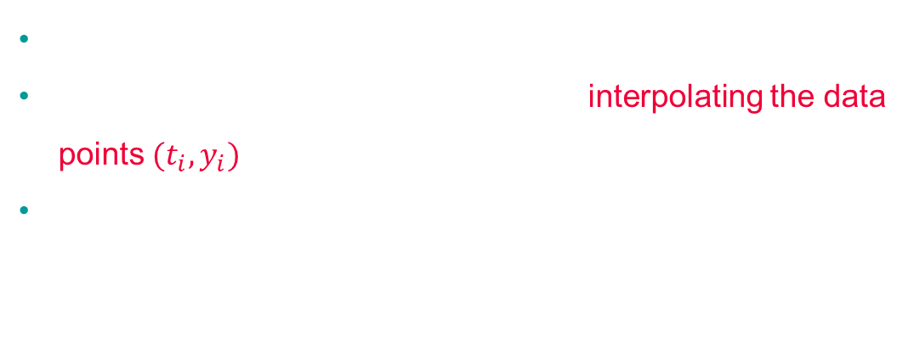
Monomial basis
To interpolate $n$ data points: $k = n−1$
Monomials are the most natural basis for $P_{n−1}$
$p_{n−1} (t) = x_{1} + x_{2}t + · · · + x_{n}t_{n−1}$
A matrix of this form is called a Vandermonde matrix
This system gives the coefficients for interpolating the data points $(t_{i}, y_{i})$
This matrix is often ill-conditioned for high-degree polynomials. Do you know why?
Notes:
Matrix whose columns are successive powers of some independent variable t

Slide 11
Monomial basis:
To illustrate polynomial interpolation using the monomial basis, we will determine the polynomial of degree two (quadratic) interpolating the three data points
(−2, −27), (0, −1), (1, 0)
Assemble the Vandermonde Matrix manually and solve it using Gaussian elimination
Notes:
[1 -2 4; 1 0 0; 1 1 1][x1 x2 x3] = [-27 -1 0]
Answer is p2(t) = −1 + 5t − 4t2

Slide 12

Lagrange basis
Consider $n + 1$ distinct points $x_{0}, x_{1}, …x_{n}$ and $y_{0}, y_{1}, …y_{n}$ on the interval $[a, b]$.
There exists one and only one polynomial $P_{n}$ of degree less or equal to $n$ satisfying
$$P_{n}\left(x_{i} \right)= y_{i}, ∀i = 0, 1, . . . , n$$
which writes
$$P_{n}\left(x\right)=\sum_{i=0}^{n}{y_{i}}L_{i}\left(x\right) with L_{i}\left(x\right)=\prod_{k=0, k≠i}^{n}{\frac{(x−x_{k})}{\left(x_{i}−x_{k}\right)}}$$
This polynomial Pn is called Lagrange interpolation polynomial at the points $x_{0}, x_{1}, …x_{n}$ .
The polynomials $L_{i} (x)$ are the Lagrange basis functions associated to the points xi:
At the points $x_{0}, x_{1}, …x_{n},$ only one basis function is “active” and equal to 1 (Vandermonde is identity)
making Lagrange interpolation straightforward and intuitive
Notes:
It is equal to one when x = x_i and 0 otherwise

Slide 13
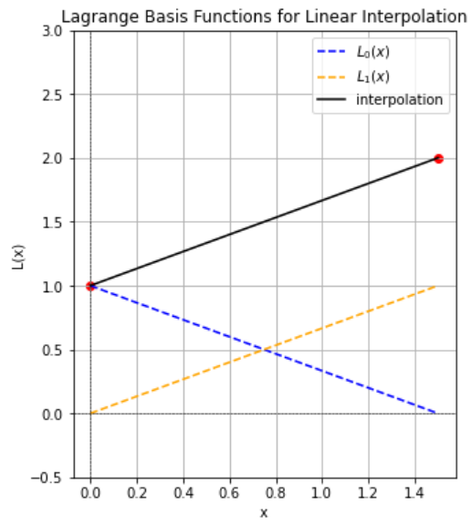

Lagrange Interpolation
With two points $n = 1$ (linear)
$$P_{1}\left(x\right)= y_{0}\frac{x − x1}{x_{0}−x_{1}}+y_{1}\frac{x − x0}{x_{1}−x_{0}}$$
With three points $n =2$ (quadratic)
→ Exercise #1

Slide 14
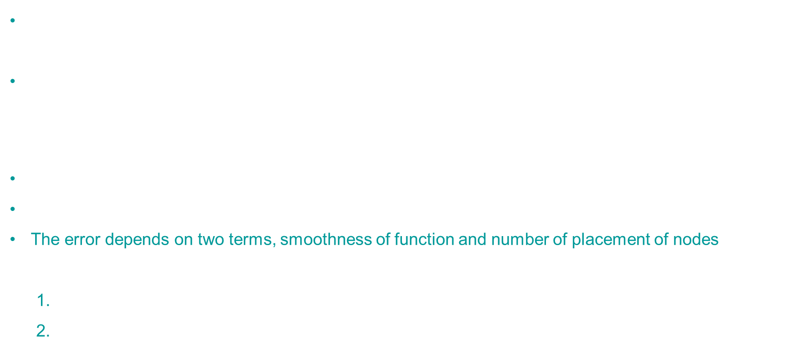
How good is polynomial interpolation?
For a continuous function $f(x)$, what is the approximation error when we replace it by $P_{n}\left(x\right)?$
$$E_{n}(x) = f(x) − P_{n}(x), x ∈ [a, b]$$
Theoretical result: if $f$ has $n + 1$ bounded derivatives:
$$E_{n}\left(x\right)=\frac{f^{\left(n+1\right)}\left(ξ\right)}{\left(n+1\right)!} π_{n}(x), ξ ∈ [a, b]$$
Where $π_{n}\left(x\right)= \prod_{i=0}^{n}{(x−x_{i})}$.
If $x$ is node than $E_{n}\text{=0}$, which is expected ☺
The error depends on two terms, smoothness of function and number of placement of nodes. More precisely
The ${\left(n+1\right)}^{th}$ derivative of $f$
the maximum of the function $π_{n}$, which only depends on the choice of $x_{i}$

Slide 15
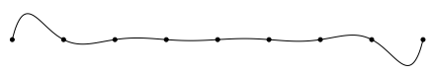
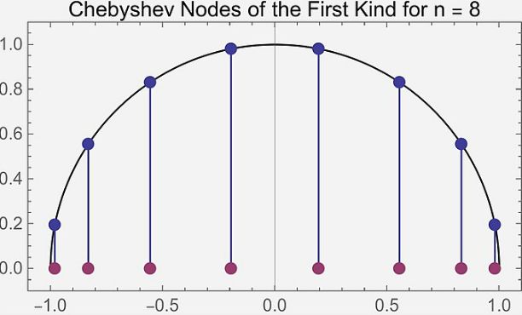
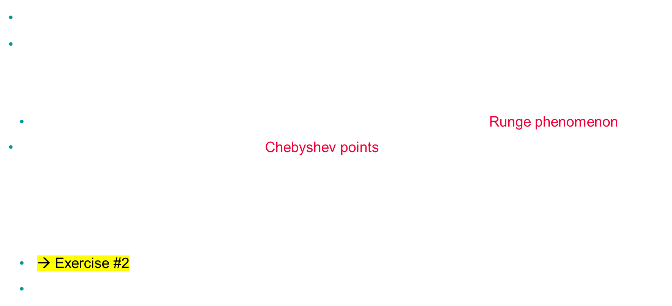
Choice of interpolation points
We can try to minimize $\max\left|π_{n}\left(x\right)\right|$ by a better choice of the points $x_{i}$
Choosing equally distributed points is far from being optimal! $π_{8}\left(x\right)= \prod_{i=0}^{8}{(x−x_{i})}$
In some occasions, it is unstable, error can grow with polynomial order (Runge phenomenon)
The optimal choice is obtained by the Chebyshev points
$x_{i}=\frac{a+b}{2}+\text{cos}\left(\frac{\left(2i+1\right)π}{2n+2}\right) \frac{b−a}{2}$
→ Exercise #2
Another way to avoid Runge phenomena is by piecewise interpolation (linear, quadratic, spline)

Slide 16
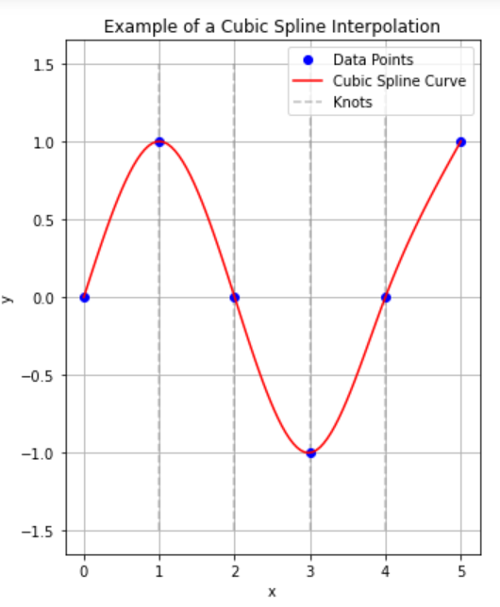
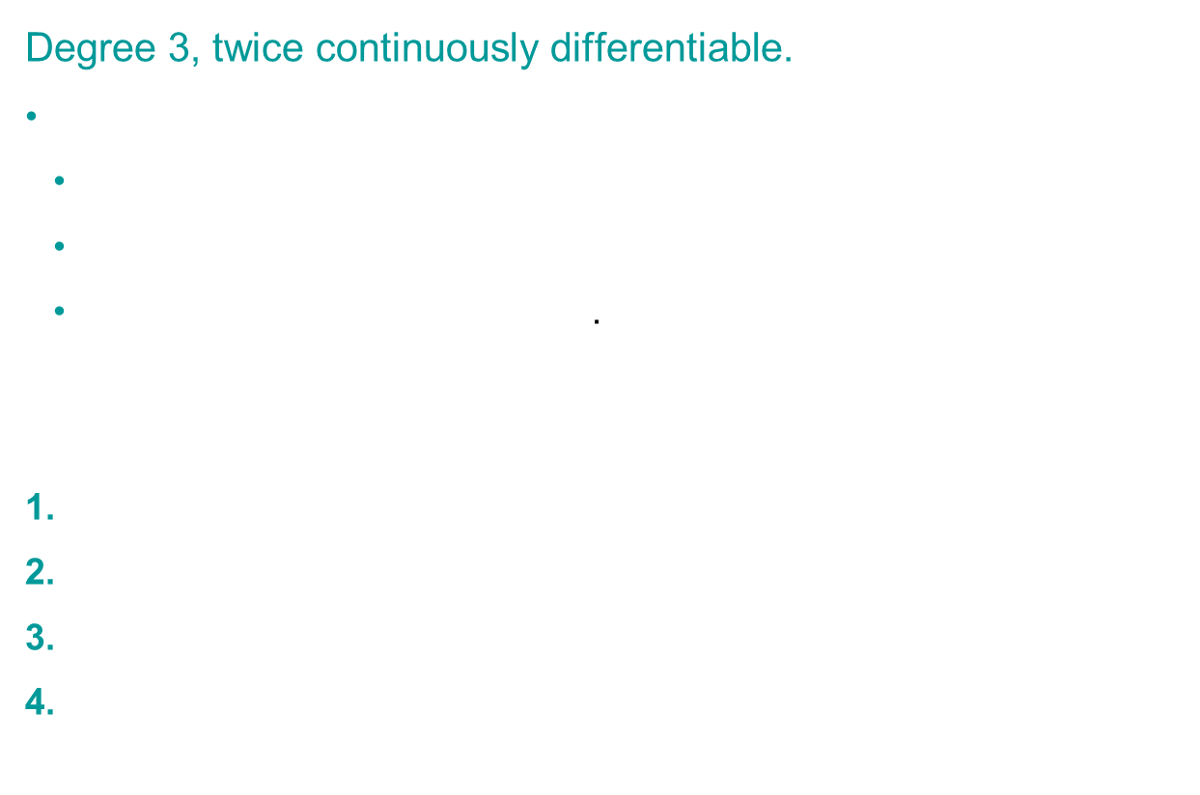
Cubic splines
Degree 3, twice continuously differentiable.
Constraints for Cubic Splines
Interpolation & First Derivative Continuity: $3n−4$ constraints.
Continuous Second Derivative: Adds $n−2$constraints.
Remaining: 2 free parameters. (can you explain why?)
Parameter Setting Methods
First Derivative: estimated at Endpoints
Natural: Second derivative = 0 at endpoints.
"Not-a-Knot": Matches segments at internal points.
Periodic: Matches 1st and 2nd derivatives at endpoints.
→ Exercise #3

Slide 17
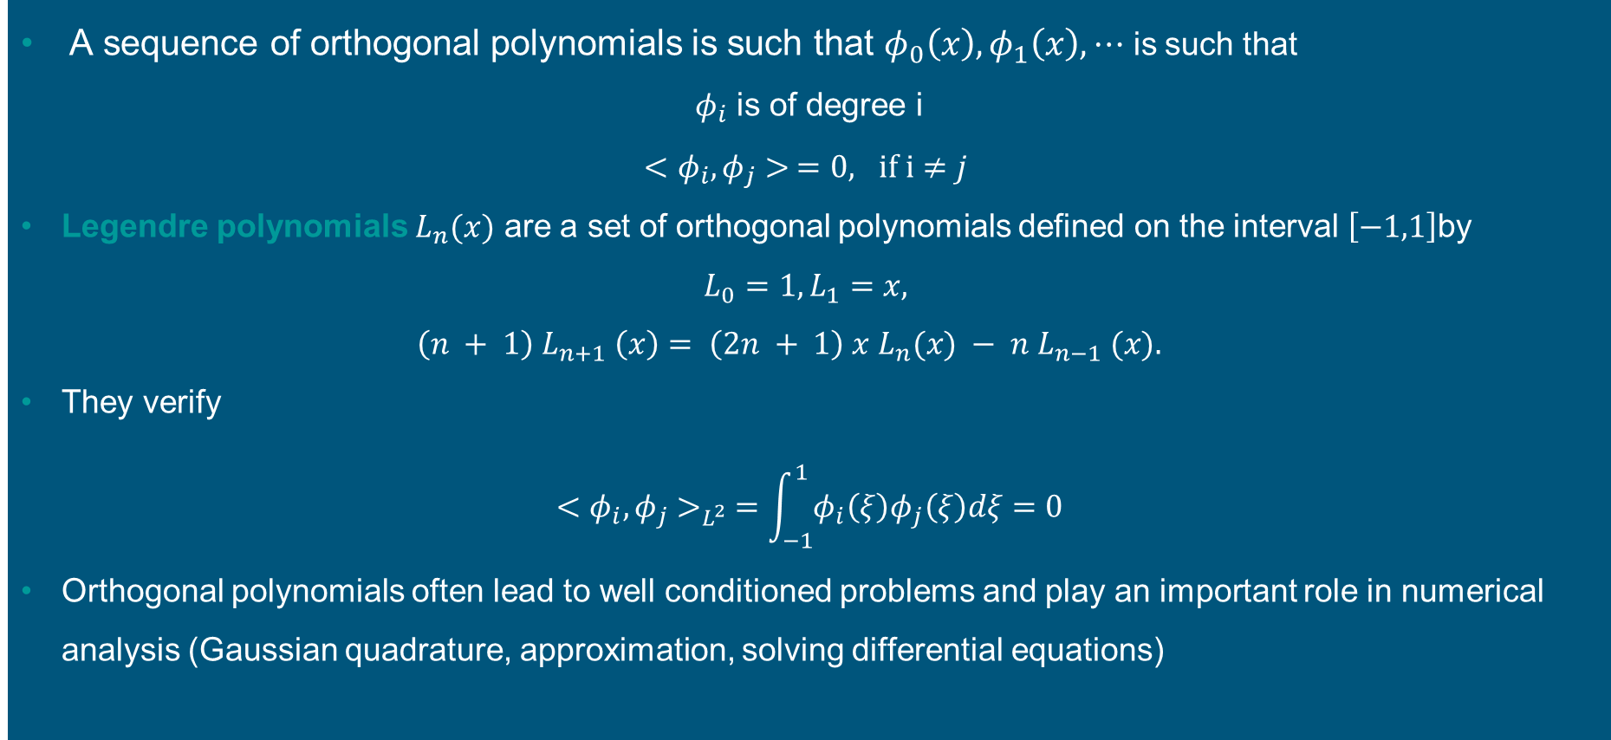
Orthogonal polynomials
A sequence of orthogonal polynomials is such that $φ_{0}\left(x\right), φ_{1}\left(x\right), ⋯$ is such that
$φ_{i}$ is of degree i
$<φ_{i}, φ_{j}> =0, if i≠j$
Legendre polynomials $L_{n}(x)$ are a set of orthogonal polynomials defined on the interval $\left[−1,1\right]$by
$$L_{0}=1, L_{1}=x,$$
$$\left(n + 1\right) L_{n+1} \left(x\right)= \left(2n + 1\right) x L_{n}(x) − n{ L}_{n−1} (x).$$
They verify
$$<φ_{i}, φ_{j}>_{L^{2}} =\int_{−1}^{1}{φ_{i}\left(ξ\right)φ_{j}\left(ξ\right)dξ}=0$$
Orthogonal polynomials often lead to well conditioned problems and play an important role in numerical analysis (Gaussian quadrature, approximation, solving differential equations)

Slide 18
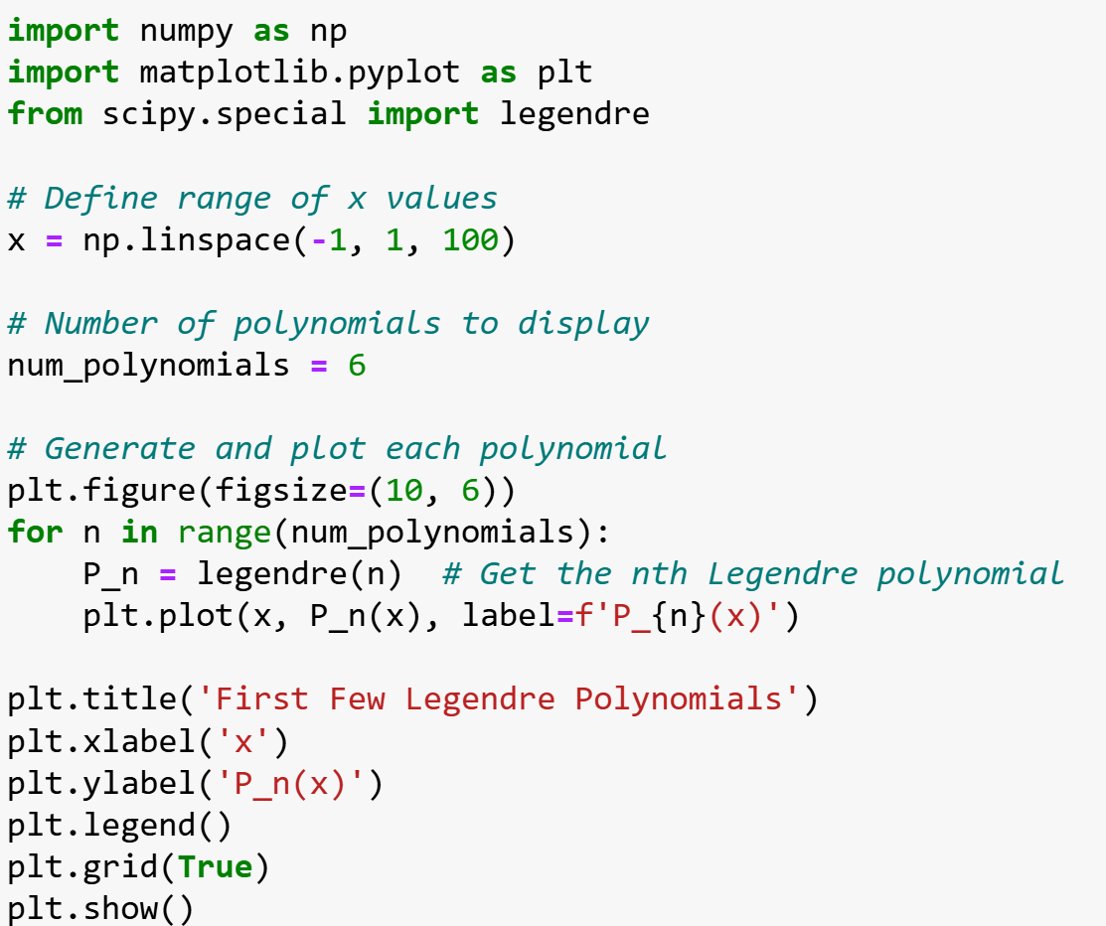
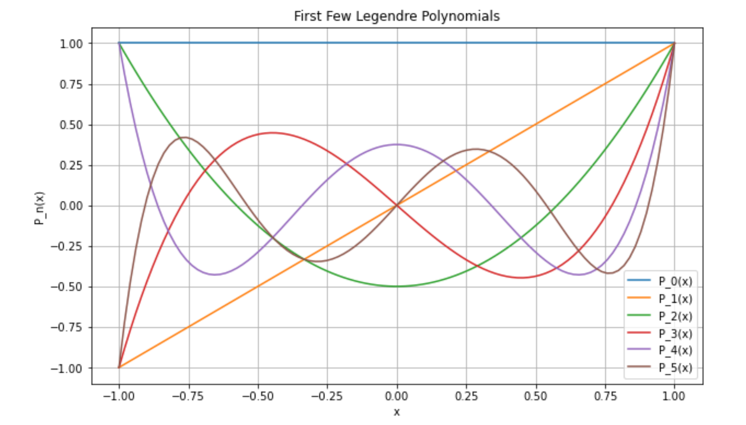

Orthogonal polynomials
$$<φ_{i}, φ_{j}>_{L^{2}} =\int_{−1}^{1}{φ_{i}\left(ξ\right)φ_{j}\left(ξ\right)dξ}=0$$
Notes:
p1(t) = α1 + α2t + α3t2 + α4t3, p2(t) = β1 + β2t + β3t2 + β4t3.
8 parameters to determine

Slide 19
3. Approximation – data fitting

Slide 20
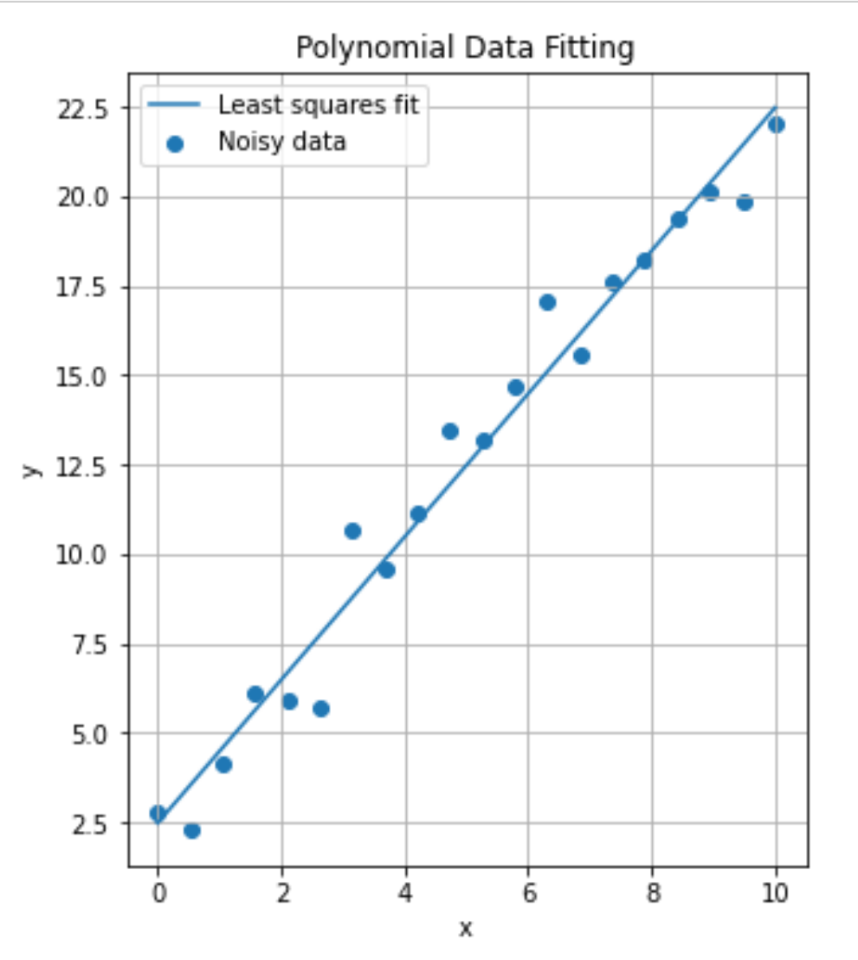
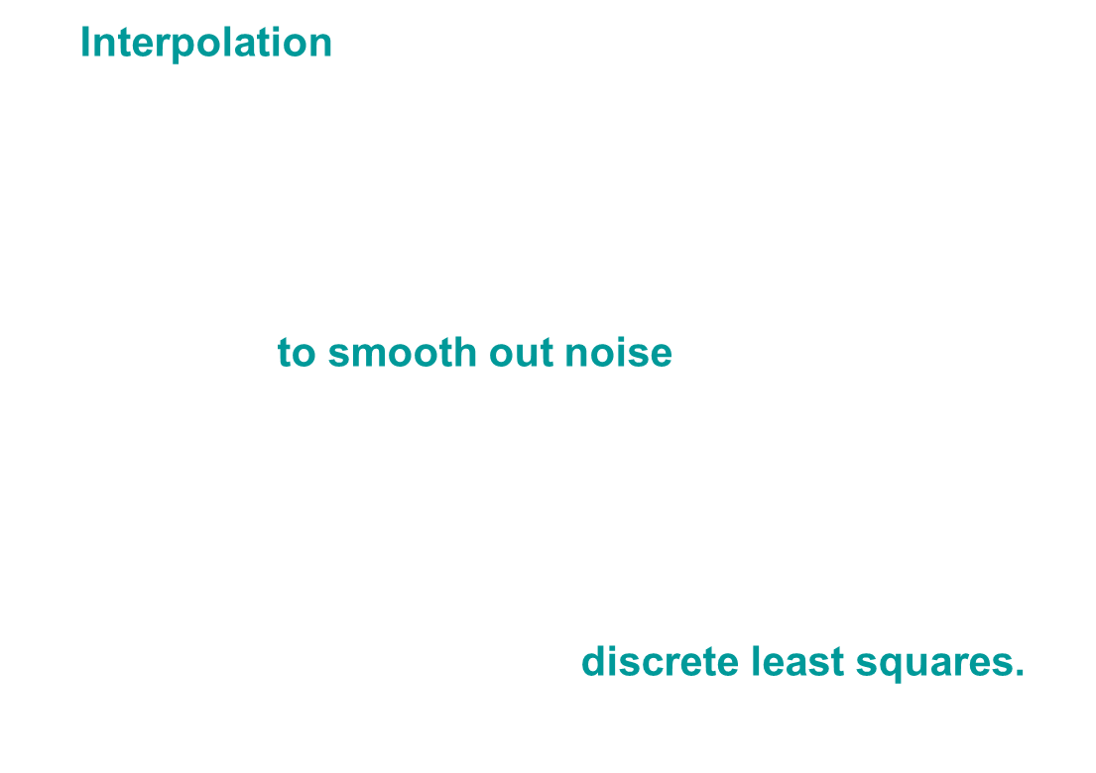
Polynomial Interpolation vs approximation
Interpolation = Exact Data Fit
In some cases (noisy or too much data), exact data fit not always appropriate
If data has experimental/significant errors, it's preferable to smooth out noise
We do not need $P$ to pass through $x_{i}$ , but only capture the main trend of $f$
we can try to fit the data to a polynomial $P$ of lower degree $n$, we talk about discrete least squares.
Notes:
Steps 2 and 3—designing, analyzing, implementing, and
using numerical algorithms and software—are the main subject matter of scientiﬁc
computing, and of this course

Slide 21
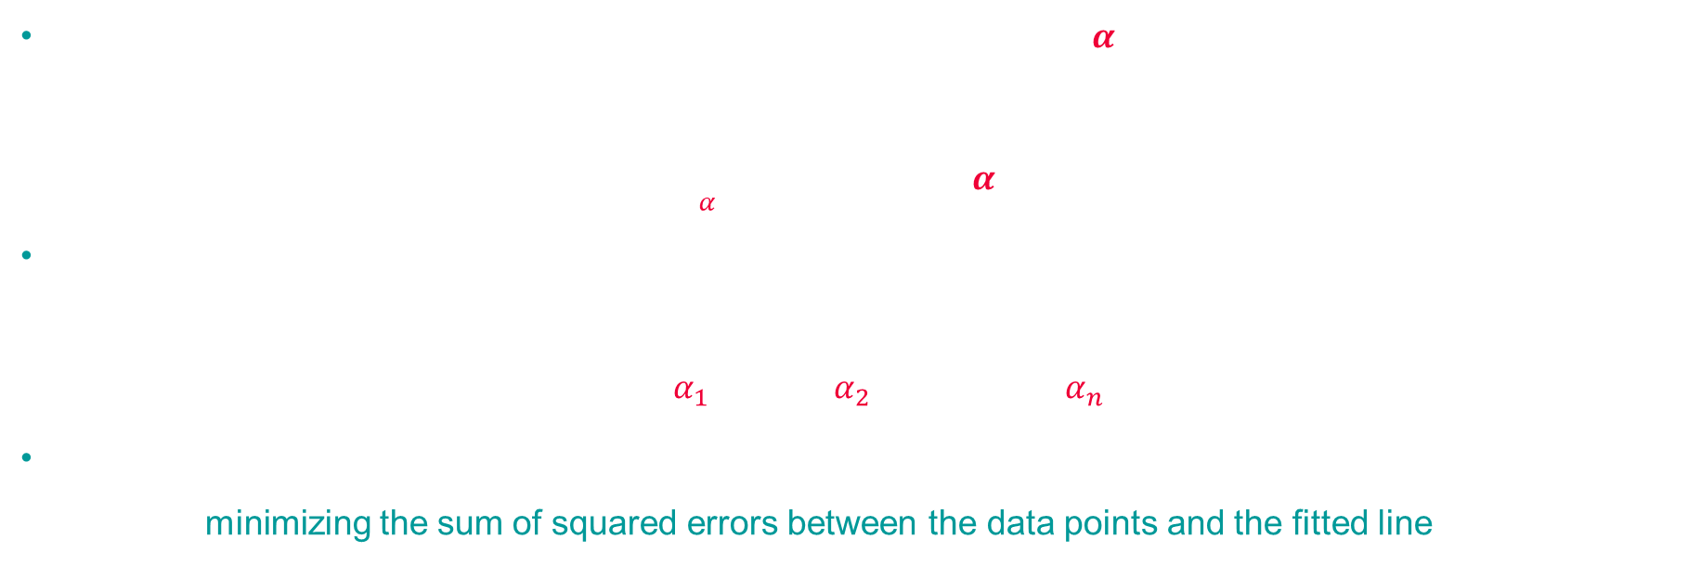
Data fitting
t | 1.0 | 2.0 | 3.0 | 4.0 | 5.0 | 6.0
y | 1.9 | 2.7 | 4.8 | 5.3 | 7.1 | 2.4
Given data points $(t_{i}, y_{i}), i = 1, . . . , m$, we wish to ﬁnd the $n$-vector $α$ of parameters that gives the “best ﬁt”, where by best ﬁt we mean in the least squares sense
$\min_{α}$ $\sum_{i=1}^{m}{{\left(y_{i}−f\left(t_{i},α\right)\right)}^{2}}$
A data fitting is linear if the function f is linear in the components of the parameter vector $α$, which means that $f$is a linear combination
$$f\left(x,t\right)=α_{1}φ_{1}\left(t\right)+α_{2}φ_{2}\left(t\right)+⋯+α_{n}φ_{n}(t)$$
of functions $φ_{j}$that depend only on $t$. In least squares fitting, the algorithm essentially "finds" the best curve by minimizing the sum of squared errors between the data points and the fitted line
Notes:
Steps 2 and 3—designing, analyzing, implementing, and
using numerical algorithms and software—are the main subject matter of scientiﬁc
computing, and of this course

Slide 22
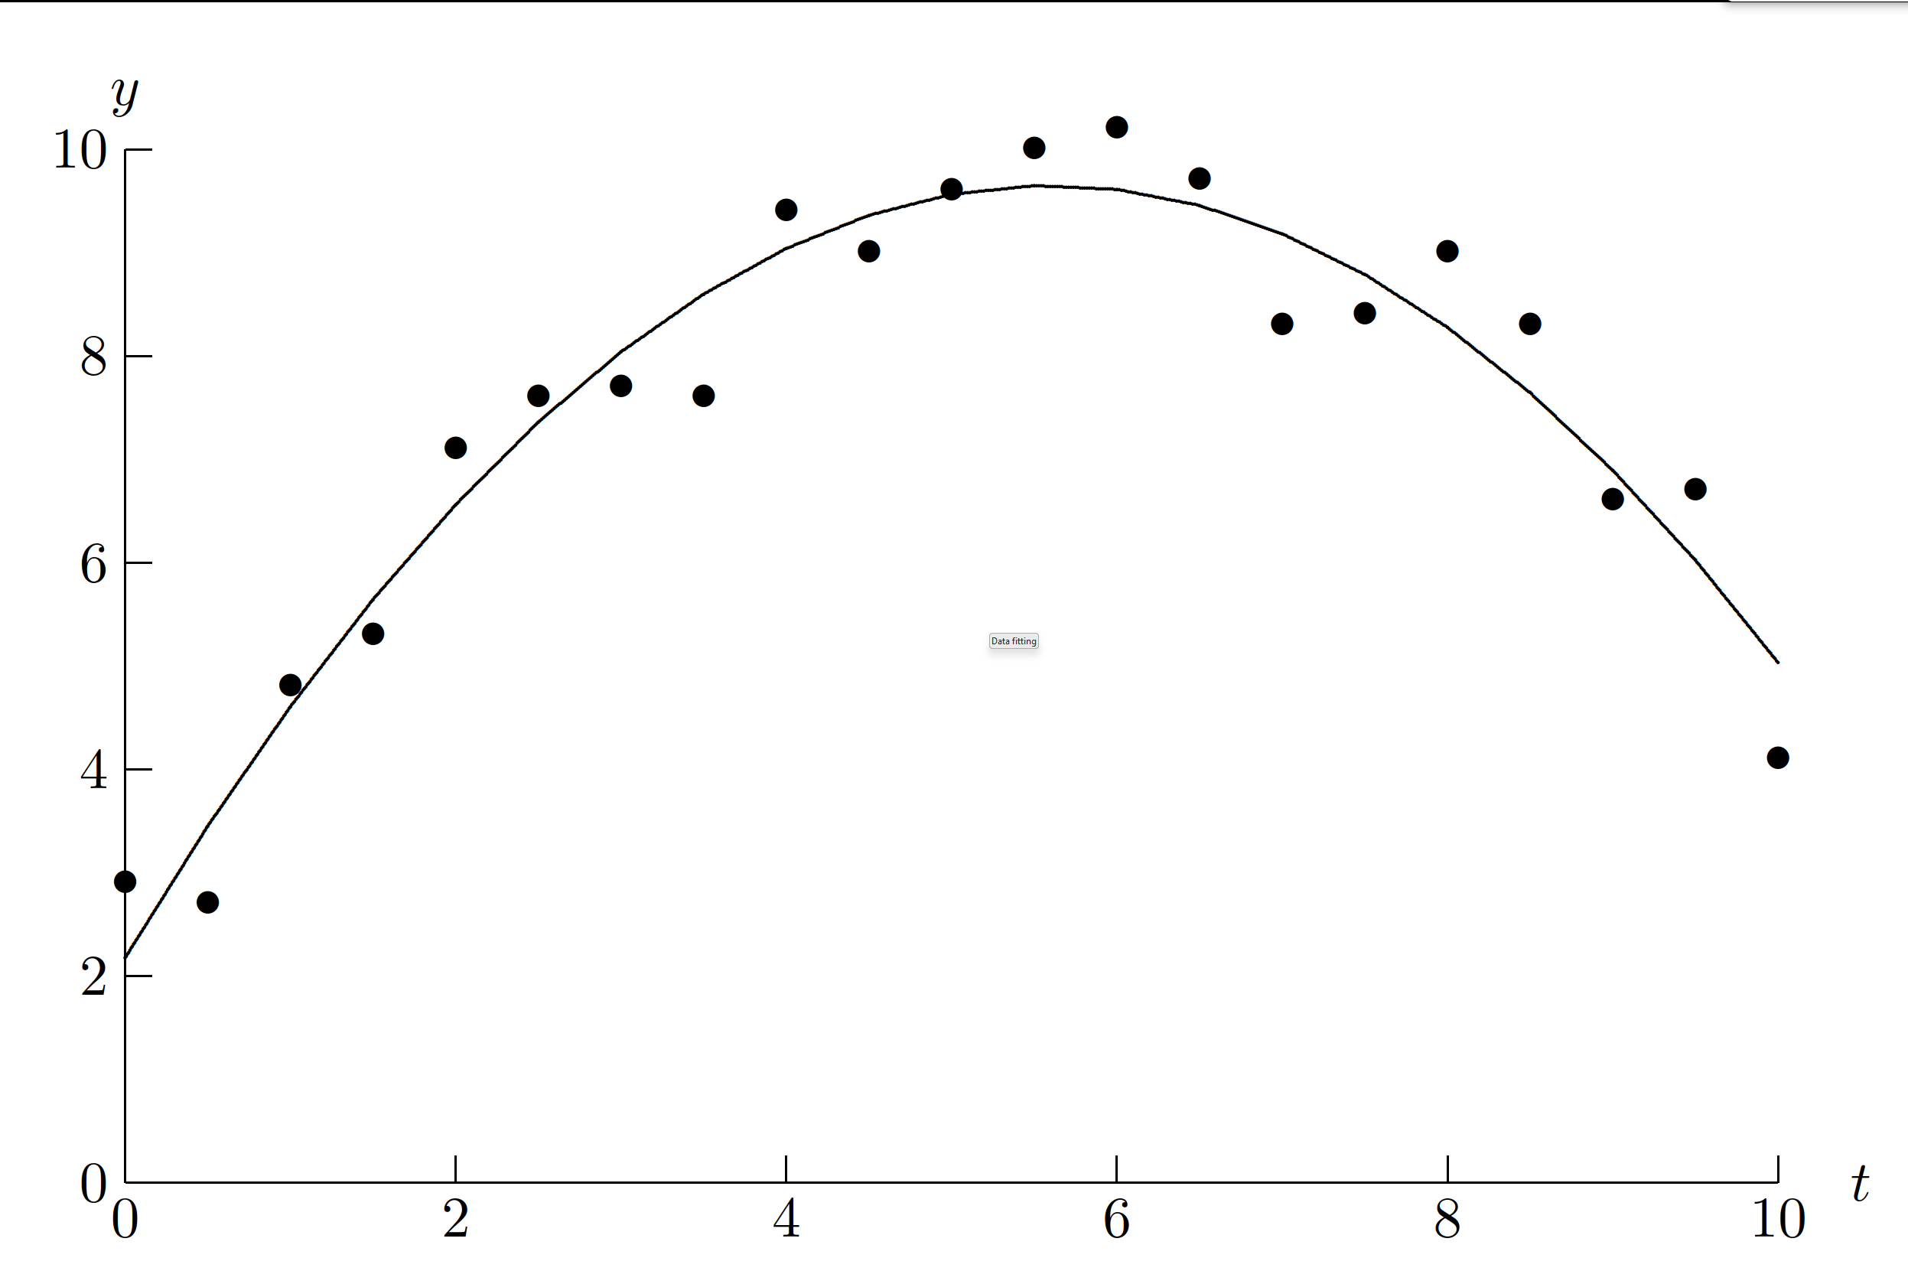

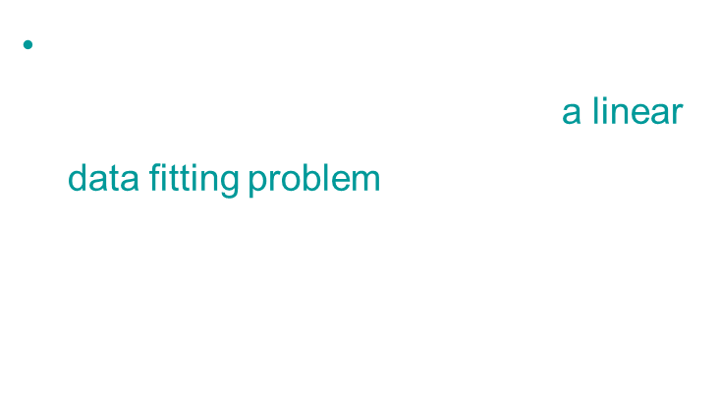

Linear data fitting - or linear regression
For example, polynomial ﬁtting, with $f\left(t, α\right)= α_{1} + α_{2}t + α_{3}t^{2}$ is a linear data fitting problem, although it is obviously quadratic in $t$!
the "linear" part refers to the
linearity in the $α$coefficients
Least squares ﬁt of quadratic polynomial to given data.

Slide 23
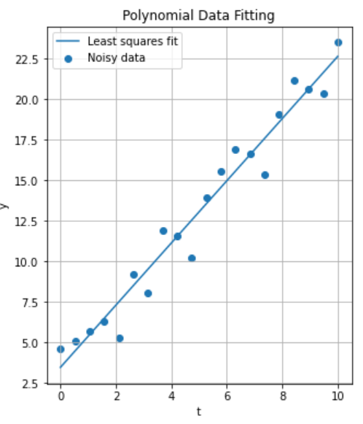
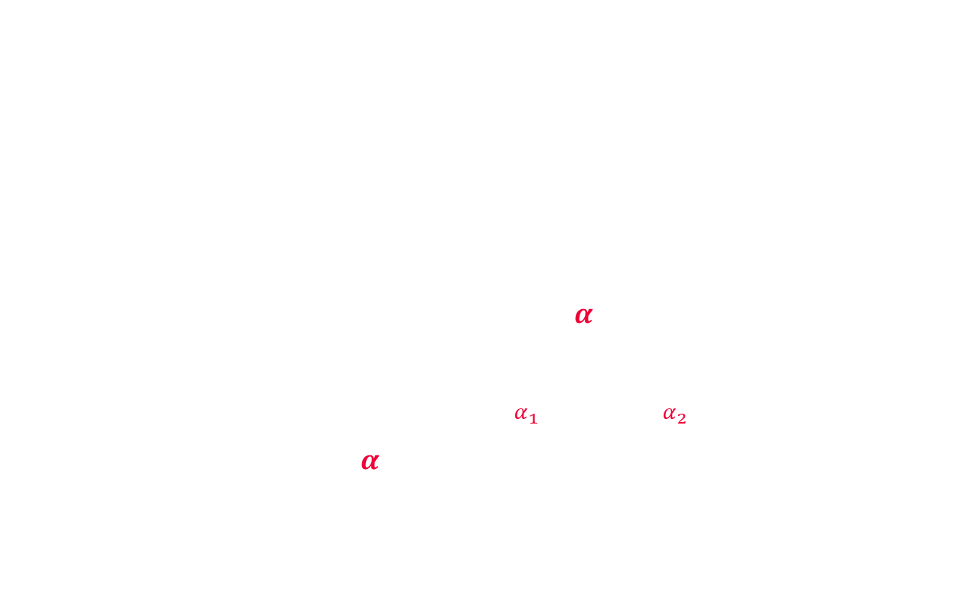
Data fitting - example
Let us do some data fitting on this set of points using least squares
At first sight it looks like a linear function will do a good job
So we need to find $α_{1} and α_{2}$ in the function $f\left(t, α\right)= α_{1} + α_{2}t$
$$ε=\sum_{i=1}^{6}{{\left(y_{i}−f\left(t_{i},α\right)\right)}^{2}}$$
To minimize this function we can get $\frac{∂ε }{∂α_{1}}=0$ and $\frac{∂ε }{∂α_{2}}=0$
$\frac{∂ε }{∂α_{1}} =−2\sum_{i=1}^{6}{\left(y_{i}−f\left(t_{i},α\right)\right)=0}$, and $⋯$
Which is complex…
t | 1.0 | 2.0 | 3.0 | 4.0 | 5.0 | 6.0
y | 1.9 | 2.7 | 4.8 | 5.3 | 7.1 | 2.4

Slide 24
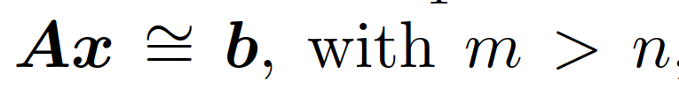


Data fitting - example
Instead, it is easier to construct the Vandermonde matrix
$\left[\begin{matrix}1 & t_{1} \\ ⋮ & ⋮ \\ 1 & t_{6}\end{matrix}\right]\left[\begin{matrix}α_{1} \\ α_{2}\end{matrix}\right]=\left[\begin{matrix}y_{1} \\ ⋮ \\ y_{6}\end{matrix}\right]$
The solution of this overdetermined system (we have more equations than unknowns)
can be computed using linear algebra packages
t | 1.0 | 2.0 | 3.0 | 4.0 | 5.0 | 6.0
y | 1.9 | 2.7 | 4.8 | 5.3 | 7.1 | 2.4
$f\left(t, α\right)= α_{1} + α_{2}t$

Slide 25
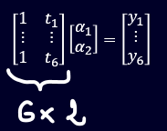
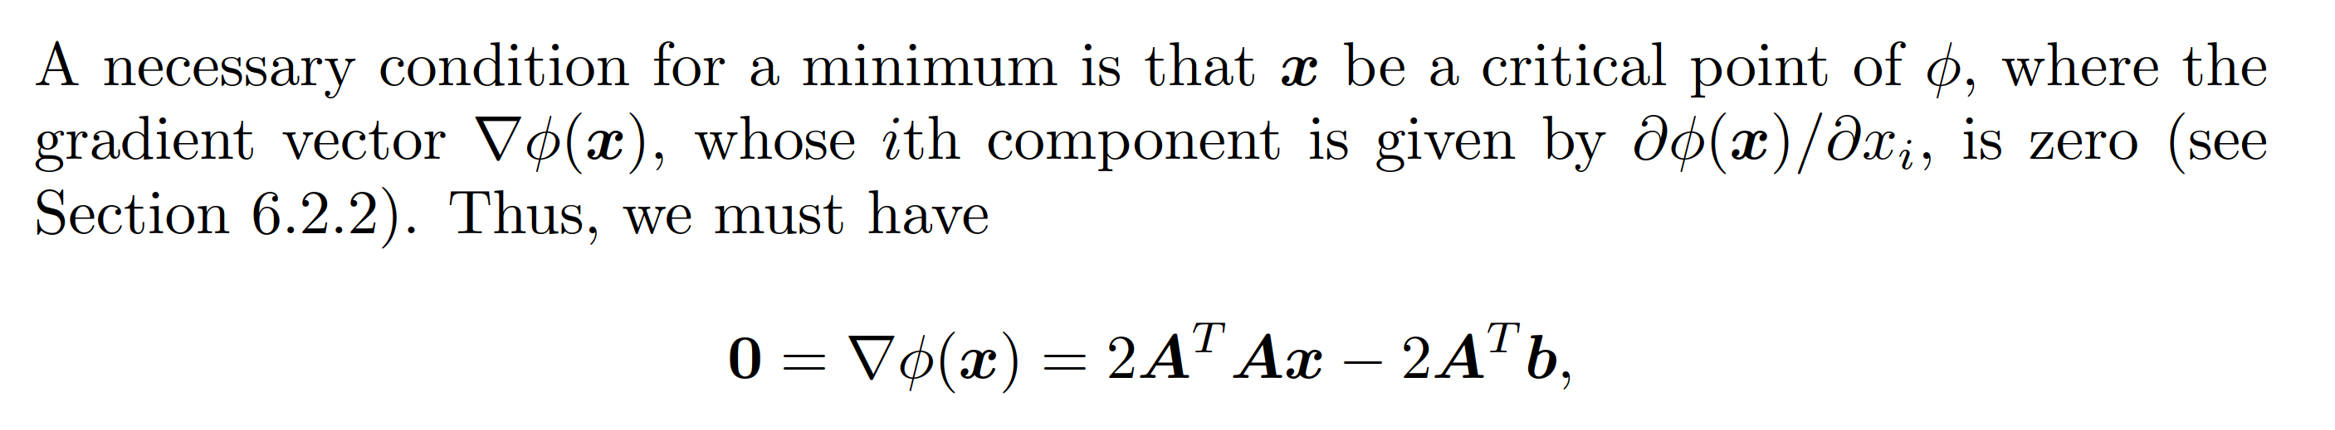
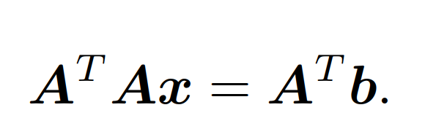

Normal Equations
We wish to minimize the squared Euclidean norm of the residual vector $r = b − Ax$
A necessary condition for a minimum is that $x$ be a critical point of $Φ$, where the gradient vector $∇Φ\left(x\right)$is zero
We finally get to
This is the system of normal equations, or cross matrix product of A, which is a standard linear system

Slide 26



Normal equation
$\left[\begin{matrix}1 & ⋯ & 1 \\ t_{1} & ⋯ & t_{6}\end{matrix}\right]\left[\begin{matrix}1 & t_{1} \\ ⋮ & ⋮ \\ 1 & t_{6}\end{matrix}\right]\left[\begin{matrix}α_{1} \\ α_{2}\end{matrix}\right]=\left[\begin{matrix}1 & ⋯ & 1 \\ t_{1} & ⋯ & t_{6}\end{matrix}\right]\left[\begin{matrix}y_{1} \\ ⋮ \\ y_{6}\end{matrix}\right]$
t | 1.0 | 2.0 | 3.0 | 4.0 | 5.0 | 6.0
y | 1.9 | 2.7 | 4.8 | 5.3 | 7.1 | 2.4

Slide 27
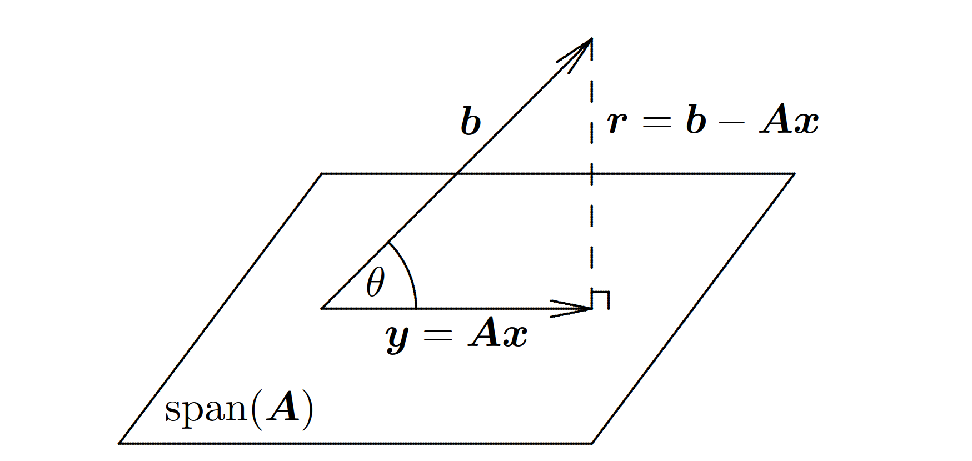

Geometric interpretation
The m-vector b generally does not lie in $span(A)$, a subspace of dimension at most $n$
The vector y = Ax ∈ span(A) closest to $b$ in the Euclidean norm occurs when the residual vector r = b − Ax is orthogonal to $span(A)$
Residual vector $r = b − Ax$ must be orthogonal to each column of $A$, $A^{T} r = 0$
→ Exercise #4 and #5
Notes:
Early development of the method of least squares was due largely to Gauss, who
used it for solving problems in astronomy, particularly determining the orbits of
celestial bodies such as asteroids and comets. The elliptical orbit of such a body is
determined by ﬁve parameters, so in principle only ﬁve observations of its position should be necessary to determine the complete orbit.
Owing to measurement errors, however, an orbit based on only ﬁve observations
would be highly unreliable. Instead, many more observations are taken, and the
method of least squares is used to smooth out the errors and obtain more accurate
values for the orbital parameters. Least squares approximation reduces the dozens
or hundreds of observations, which lie in a correspondingly high-dimensional space,
down to the ﬁve-dimensional parameter space of the elliptical orbit model.

Slide 28
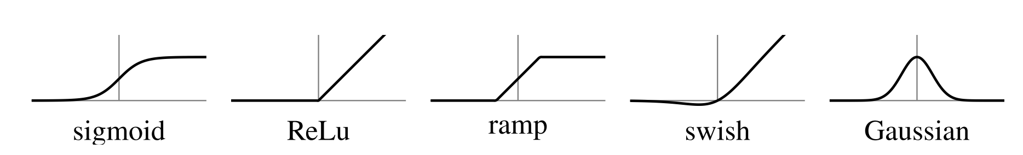
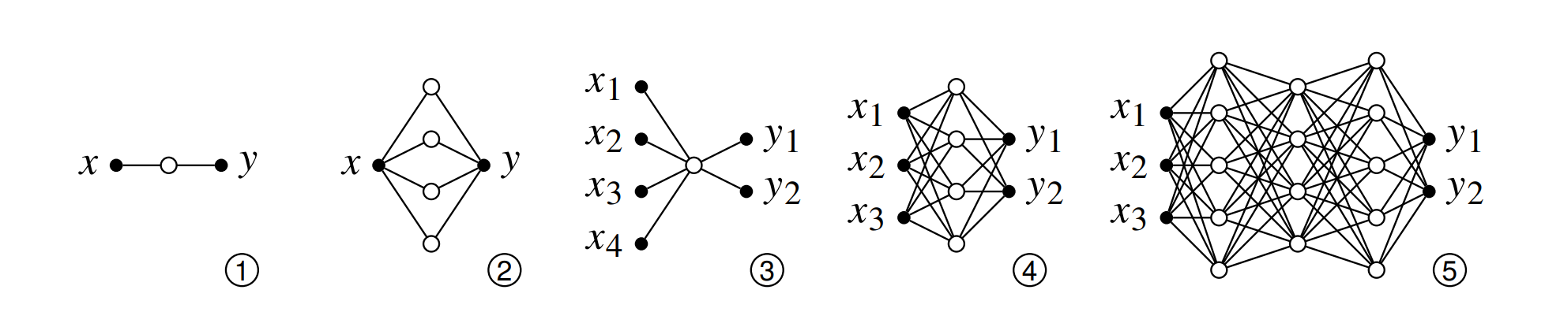
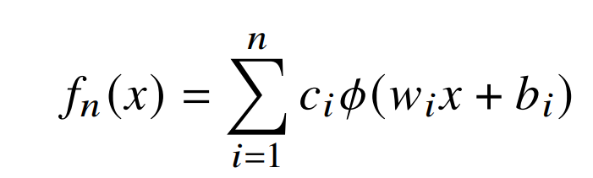
Machine Learning?
An artificial neuron is a function consisting of the composition of two affine transformations and a nonlinear function 𝜙(𝑥), called an activation function, which acts as a basis function
The first affine transformation affects the input values by stretching and sliding the activation function along the 𝑥-axis.
The second affine transformation affects the output values by stretching and sliding the activation function in the 𝑦-direction
An activation function could be any number of functions, polynomial, spline, Gaussian, etc…
Now, rectified linear units or ReLUs are in vogue (simplicity and effectiveness in deep learning)
We can approximate any function f(x), provided we have enough neurons (parameters)
Notes:
Weighted edges – synaptic weights
Input/Output relation that is minimized using gradient descent

Slide 29
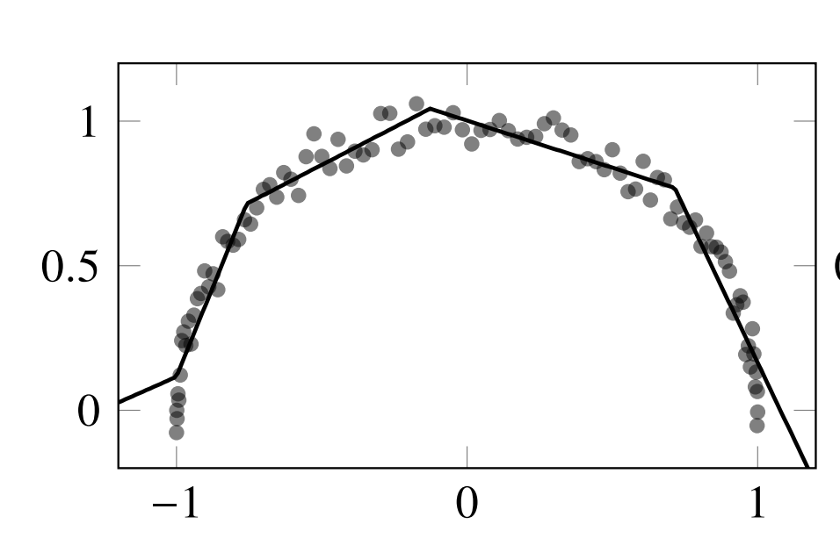
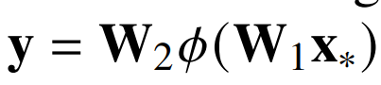

Machine Learning?
We often want to find the “best” function that fits a data set with $m$ input/output values
Our model has $n$ parameters with $m>>n$
$x$ has $m$-elements, $y$ has n-dimensions (labels)
The minimization problem (finding the weights on synapses) are found using the gradient descent method
GPT-3 (Generative Pre-trained Transformer 3) used for natural language generation, has 96 layers with over 175 billion parameters
neural network approximation for the data using ReLU activation functions
Notes:
The parameters W1 and W2 are 𝑘 × 𝑚 and 𝑛 × 𝑘 matrices, where 𝑘 is a hyperparameter of the algorithm independent of the problem. All-in-all, we need to determine 𝑘𝑚𝑛 parameters, although many of these parameters may be zero.
A neural network on a one-dimensional problem with a small number of parameters is wholly inefficient. Any number of universal approximators like Chebyshev polynomials or B-splines would provide a better solution in a fraction of the compute time. However, these methods quickly get bogged down as the size of the problem increases

Slide 30
1.6 Summary

Slide 31
Summary
Polynomial interpolation :
1. Global polynomial interpolation (Lagrange, Legendre)
Error study: Runge phenomena, Chebyshev points
2. Local interpolation (piecewise linear, cubic splines) is more robust for non smooth functions
Higher degree local interpolation requires more data (new point, derivative(s), ...)
⇒ more unknowns to be solved
Approximation theory :
Discrete least-squares is the main method used for data fitting
It requires solving the linear system of normal equations (although more advanced methods are often used)

